Slide 1


Presenters: Other Team Members:
Jonathan Coutu Runmeng Qin
Yuchen Zhang Mingcheng xu
Shaokun Zhang
Yuxing Zhang
The work we submitted as part of this assignment is original, and due credit is given to others where appropriate. We accept and acknowledge that that each member of our team is equally responsible for if the assignment found to be plagiarized in any way, and we will be subject to school’s Academic Integrity Policy.
Gun Event Forecasting in Former Toronto Municipalities: Implications for Insurance Companies' Risk Assessment and Pricing Strategies

Slide 2
PURPOSE AND SCOPE
Insurance companies are influenced in various ways by gun violence:
Escalation in Premiums: Heightened risk related to gun violence affect premiums for people and businesses situated in areas vulnerable to gun violence.
Claims domino effect: Gun violence often triggers a domino effect in insurance claims - escalating medical expenses, life insurance benefits, and property damage.
Violence as a Risk Barometer: Gun violence can serve as a key indicator to guide insurers in evaluating a spectrum of other potential risks.
Problem Statement:
As crime rates and gun-related injuries rapidly fluctuate, insurance companies urgently need to forecast the risks associated with gun violence to swiftly adapt their policy pricing in response to emerging community safety factors
Objective:
Help insurance companies to rapidly adjust their insurance product prices using a predictive model on monthly gun-related events across the six former municipalities now constituting Toronto

Slide 3
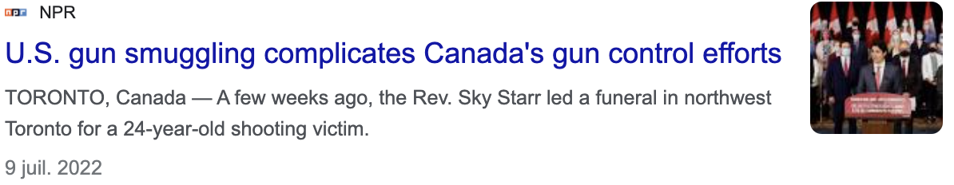
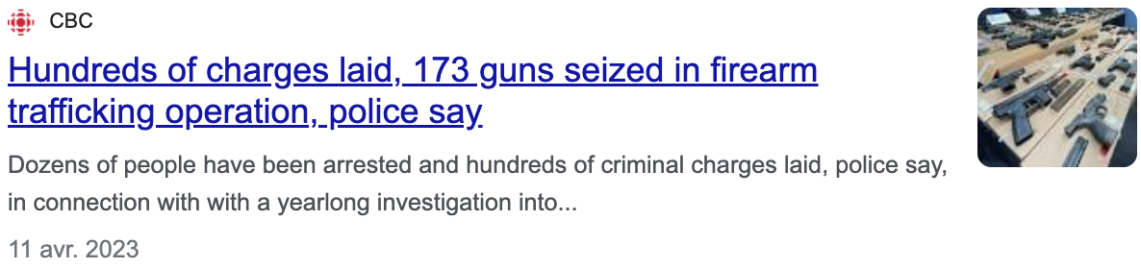
EXTERNAL ENVIRONMENT
External factors and hardly measurable variables will most certainly influence the accuracy of our predictive model:
1. Neighborhood Dynamics
A neighborhood with a history of high crime rates may undergo significant transformations, such as community revitalization efforts or increased law enforcement presence, which could lead to a decrease in crime. Such changes can result in inaccurate community security assessments and impact the success of the project. Reference: ‘Community-Based Violence Interventions: Proven Strategies To Reduce Violent Crime’
Over the past two decades, community-based violence intervention (CVI) programs have proven successful in reducing gun violence and violent crime in communities more generally, by as much as 60 percent in some communities.
For example, using architecture and urban planning to create or restore public spaces where the community can gather and feel a sense of safety, restoration of vacant lots and investment in a community’s physical environment has been proven to reduce crime and gun violence. https://www.americanprogress.org/article/community-based-violence-interventions-proven-strategies-to-reduce-violent-crime/
2.Availability of guns
The availability of firearms, or the lack thereof, can almost certainly influence the accuracy of predictive models concerning gun violence. Fluctuations in gun smuggling from the United States likely have an impact on Toronto's security, although quantifying it precisely is difficult.
Changes in gun laws, such as tightening or loosening restrictions on gun ownership, can also probably impact gun violence rates, although the potential explanatory power of such 'soft variables' will not be included in our predictive model.

Slide 4
ANALYTICAL PLAN
Data exploration:
Identification of each variables and removal of all irrelevant or meaningless obserrvations.
2. Data selection:
Removal of all variables not related to our focus on the insurance industry (OCC_DOW, OCC_DAY, OCC_DOY, DIVISION)
Removal of OCC_DATE although its components OCC_HOUR and OCC_MONTH have been retained for future data visualization and analysis.
For LONG_WGS84 and LAT_WGS84 variables, we removed them and only keeps x and y since they are the same
3. Data visualization :
By utilizing pivot tables in Excel, we have plotted a variety of charts to obtain a fundamental understanding of the correlation between each variable and have a big picture of how we make our model later.
Through these charts, we can observe the changes in the number of deaths and injuries across different years, seasons, and months. (we are not using excel to do data cleaning, it is just for using pivot table to see some key features)
4. Data Creation:
Creation of a new variable called “Region” to group all the neighborhoods into 6 groups formed by the former municipalities now forming the city of Toronto. ['YORK', 'NORTH YORK', 'EAST YORK', 'SCARBOROUGH', 'ETOBICOKE', 'TORONTO’]. We used an external dataset named “Former Municipality Boundaries” from Toronto open data website for us to create the Region variable.
Creation of a new variable called "Season" to analyse seasonnality and particular variations in the number of crimes and the number of people dead and injured across different seasons.
5. Data Cleaning
Conversion of the excel dataset to csv file in order to use python to do the data cleaning.
Remove all missing data and correct meaningless inputs (i.e., 0 y value).
6. Considering outliers
Currently, we are not addressing outliers as their presence and identification depend on the specific variables we are working with. Later in part 2, we will handle and potentially eliminate outliers depending on the sensitivity of our prediction models.

Slide 5
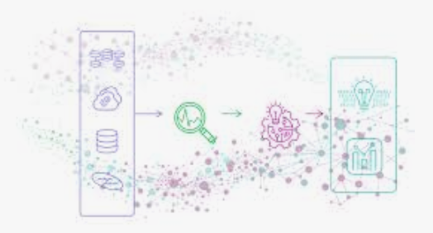
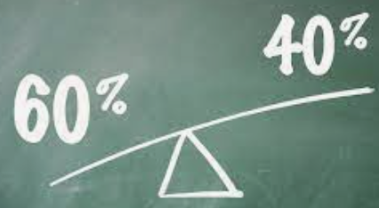
CONCLUSION & NEXT STEPS
Our objective is to offer insurance companies valuable insights that enable them to enhance the pricing structure of their insurance products, ensuring it accurately aligns with the security dynamics of each neighborhood.
Based on our data processing and preliminary analysis, here are some of the next steps to be completed in order to develop a robust predictive model for monthly gun violence per neighborhood:
ARIMA VS ARIMAX
For time series Forecasting
Seasonality and trends in the data suggest that our time series is likely non-stationary, requiring data transformation into a stationary form before modeling.
We remain uncertain about our model selection and are currently engaged in team discussions regarding the potential incorporation of external variables. Further testing will be performed in order to develop a strong model.
We plan to split the dataset into training and testing sets (60% vs 40%). We will use the training set to select the appropriate model parameters, and we will test its adequacy with statistical tests.
We will do visual exploration of our data by plotting the actual values from the testing set against the predicted values generated by our model and we will try to identify biases or trends. We will refine the model until its performance is satisfactory.

Slide 6
APPENDIX

Slide 7
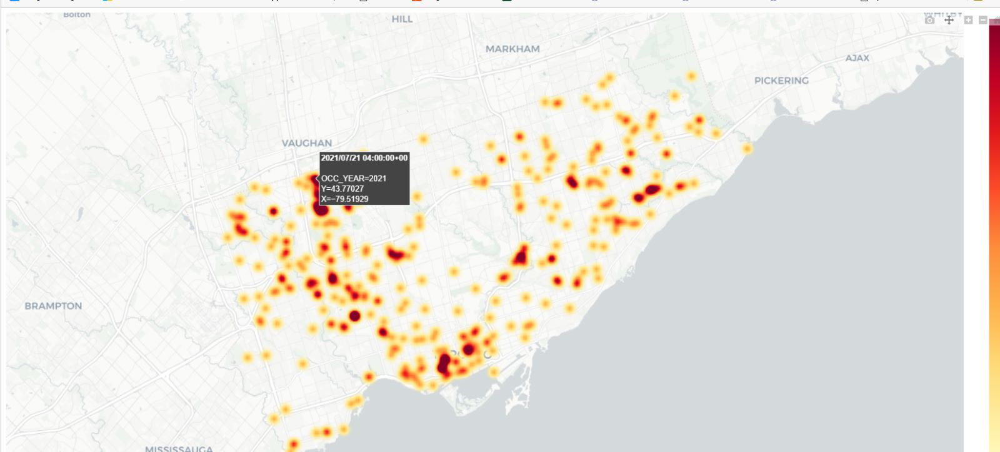
APPENDIX

Slide 8
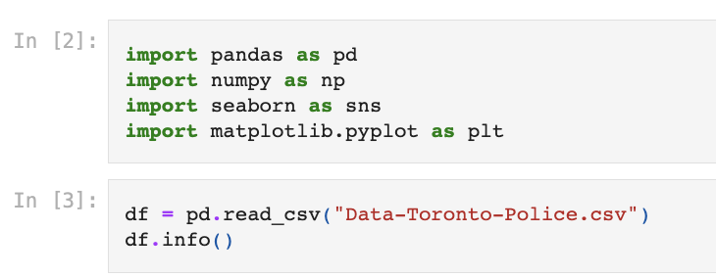
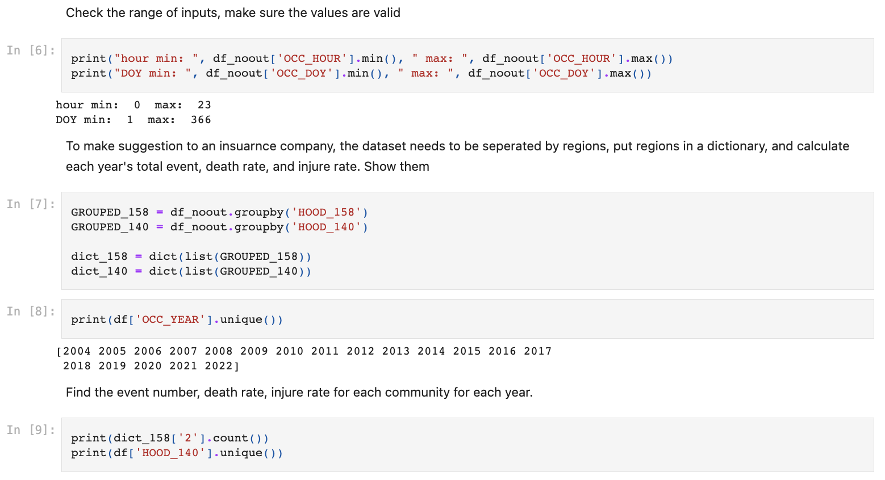
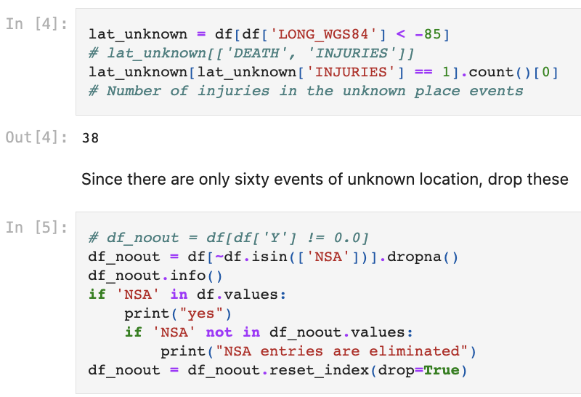
APPENDIX

Slide 9
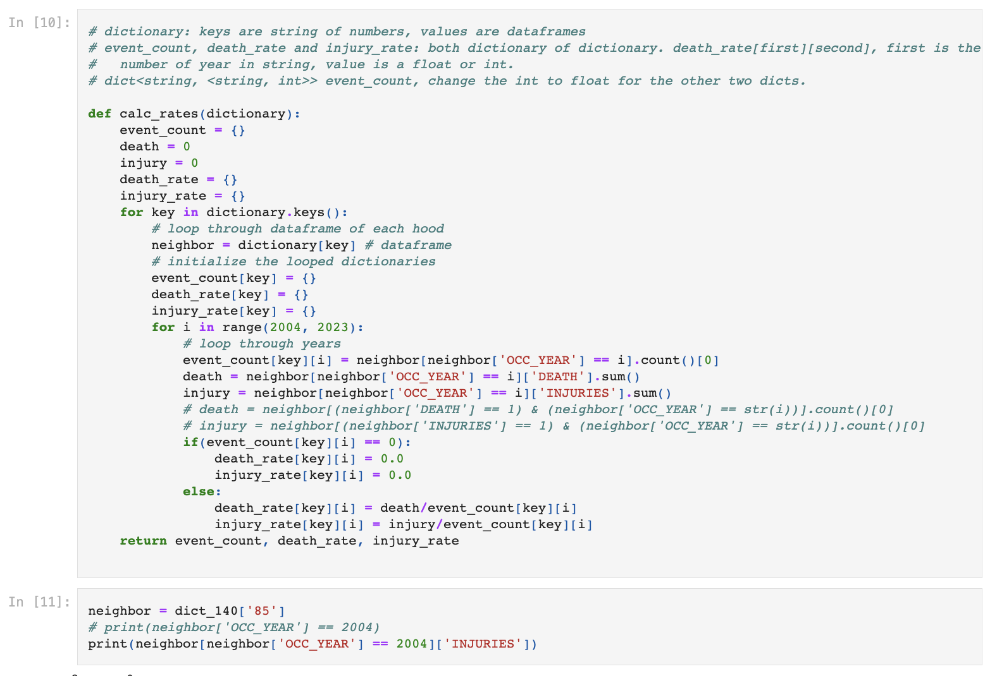
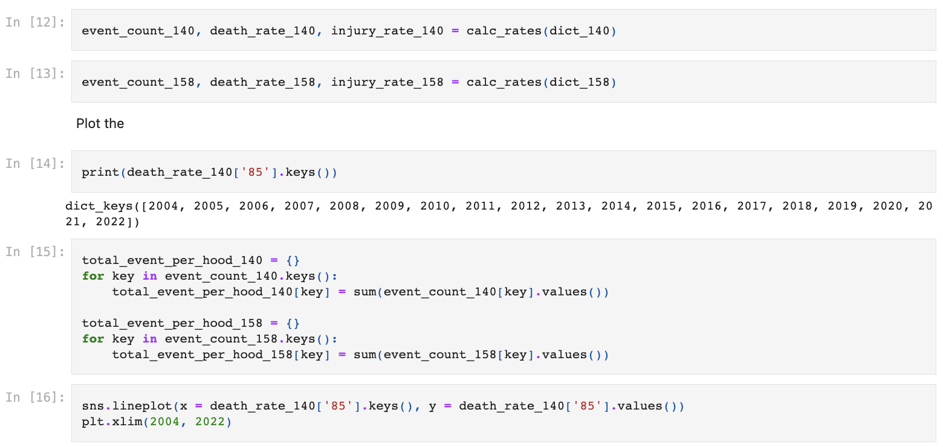
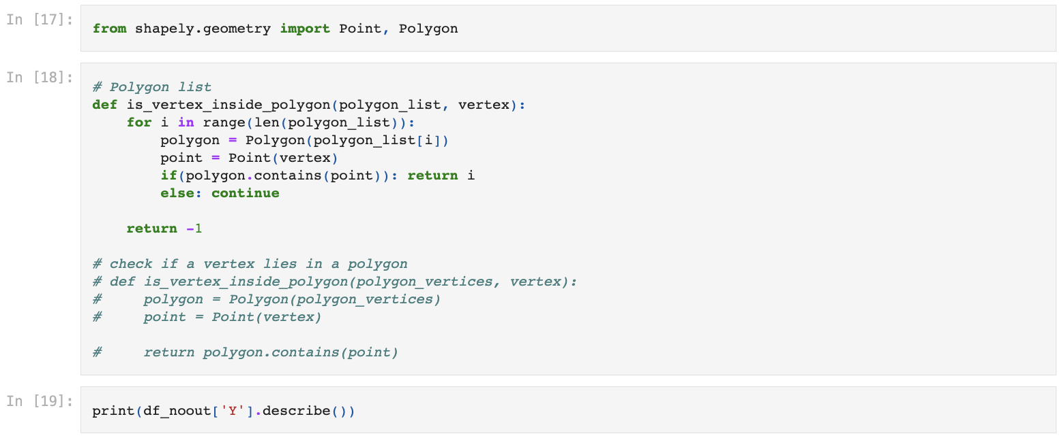
APPENDIX

Slide 10
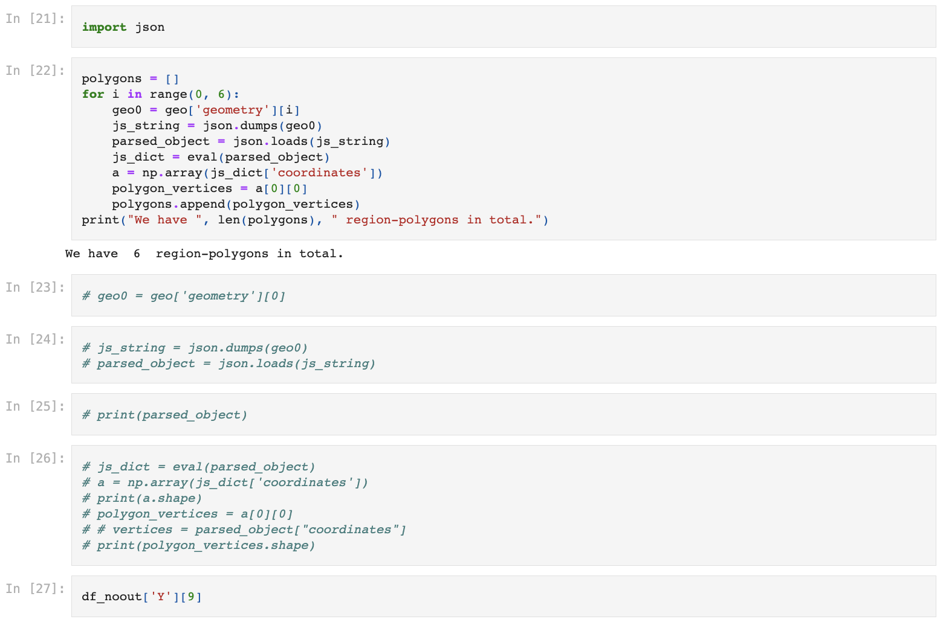
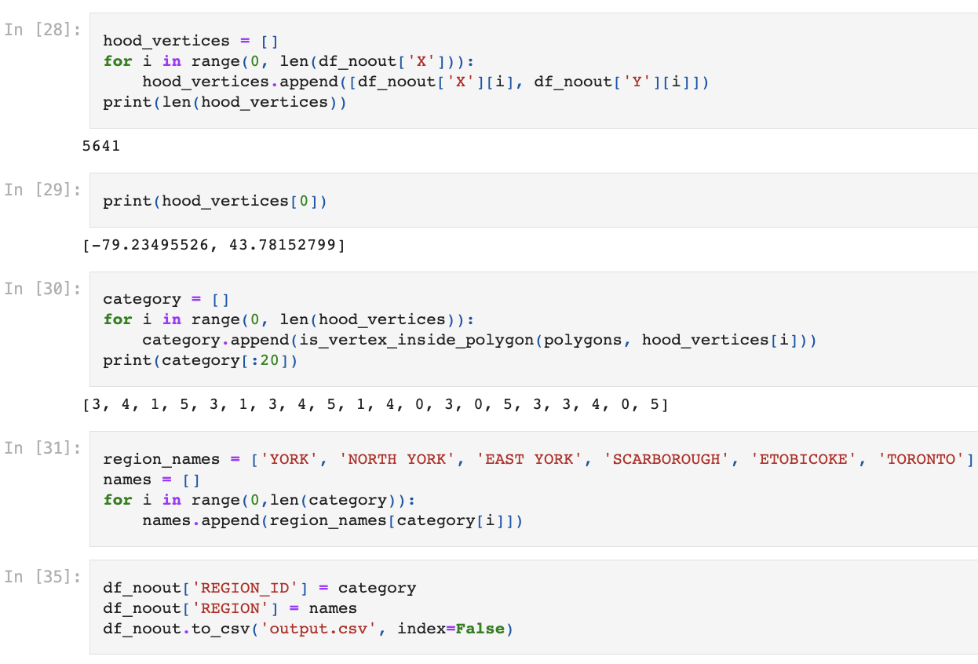
APPENDIX

